Slide 1
HOOSIER NATIONAL FOREST -DARK SKY DESIGNATION

Slide 2
LIGHT POLLUTION
Light pollution has impaired ability of millions of children to experience the spectacular starry night sky.
The redundant lighting found in many urban areas results in a clutter of lights that contribute to sky glow and glare while destroying the ambiance of our night time environment.
Notes:
This problems adversely affect our environment, safety , energy consumption and health.

Slide 3
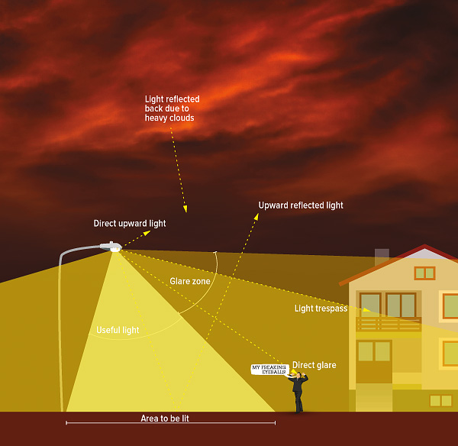
The infographic above illustrates the different components of light pollution and what “good” lighting looks like. (Image by Anezka Gocova, in “The Night Issue”, Alternatives Journal 39:5 (2013).

Slide 4
DARK SKY DESIGNATION
The International Dark Sky Association(IDA) along with Hoosier National Forest are working to protect the night skies for present and future generations.
Sensors developed by IU Informatics and Computing Professor Bryce Himebaugh will help generate data to identify accessible locations with less light pollution.

Slide 5
OUR ROLE
An interactive website to help astronomers gather data and check current and past light intensity history of the sensor location.
User and admin dashboards having an interactive map representing sensor location and data related to light intensity and the past records of sensor.
Filter or default views for the user dashboard based on user preferences.
The product generates csv files which can be used to predict new sensor locations.
A feedback system.

Slide 6
PROJECT APPROACH
Python,Django for back end development.
HTML5, JavaScript, CSS for front end development.
Database will be built using MySQL.
Jira for project tracking.

Slide 7
PROJECT PLAN
Sprint 1 : Login and registration
Sprint 2 : Add interactive map to dashboard
Sprint 3 : Search and Filter sensors
Sprint 4 : Comments and feedback feature
Sprint 5 : Additional features like storing data to csv files

Slide 8
TEAM MEMBERS
Name | Primary Role | Secondary Role
Adarsh Bhandary | Backend | Frontend
Shantanu Kotambkar | Backend | Frontend
Rahul Velayutham | Frontend | Backend
Varun Machingal | Frontend | Backend

Slide 9
FUTURE OUTLOOK
Using collected data to predict future sensor locations and dark sky designations.
Migrating from web application to mobile application

Slide 10
THANK YOU!

